Slide 1
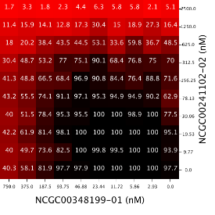
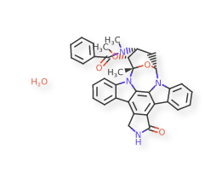
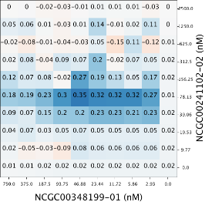
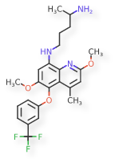
Similar Compounds Show Similar Activities- Is This True for Drug Combinations?
Intern: Sarita Lee
Mentors: Raj Guha & Lu Chen

Slide 2
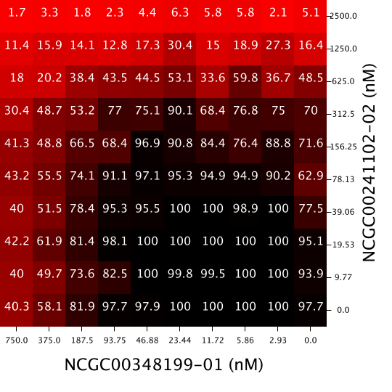
Introduction- Drug Combinations and Synergy
Response Matrix
Drug combinations are used to treat many medical conditions such as: HIV, malaria, and cancer
Sometimes the combined effect of drugs is different than their individual effects
When it is better: synergism
When it is the same: additive
When it is worse: antagonism
Drug Y
Drug X

Slide 3
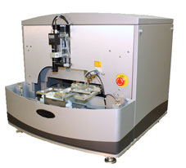
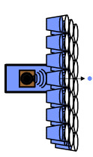
Introduction- Screening Drug Combinations
Run single agent dose responses
Traditionally, screening for drug combinations has been a slow process
Since NCATS has high throughput screening (HTS), data for thousands of drug combinations can be generated quickly
Presents opportunity to do large scale analysis
6x6 matrices for
potential synergies
Acoustic dispense,
15 min for 1260 wells, 14 min for 1200 wells
10x10 for confirmation + self-cross

Slide 4
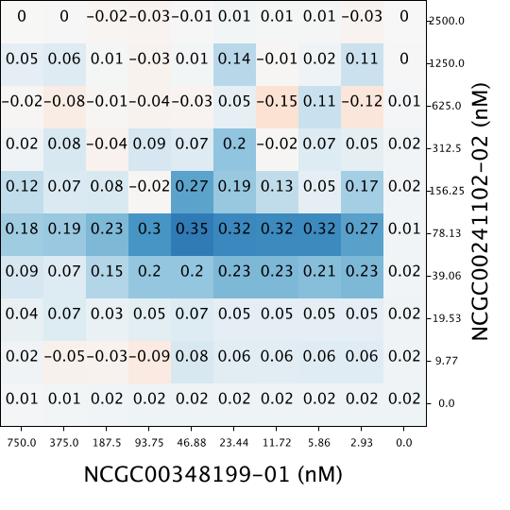
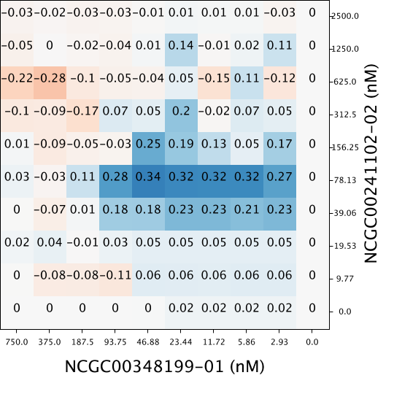
Introduction- Methods to Measure Synergy
Synergy is quantified with respect to a model of additivity
Three Models:
Highest Single Agent (HSA)
Bliss Independence Model
Loewe Additivity Model
Used Bliss Independence Model: convenient and more robust in high throughput setting
Response Matrix
Synergy Matrix-
HSA
Synergy Matrix-
Δ Bliss

Slide 5
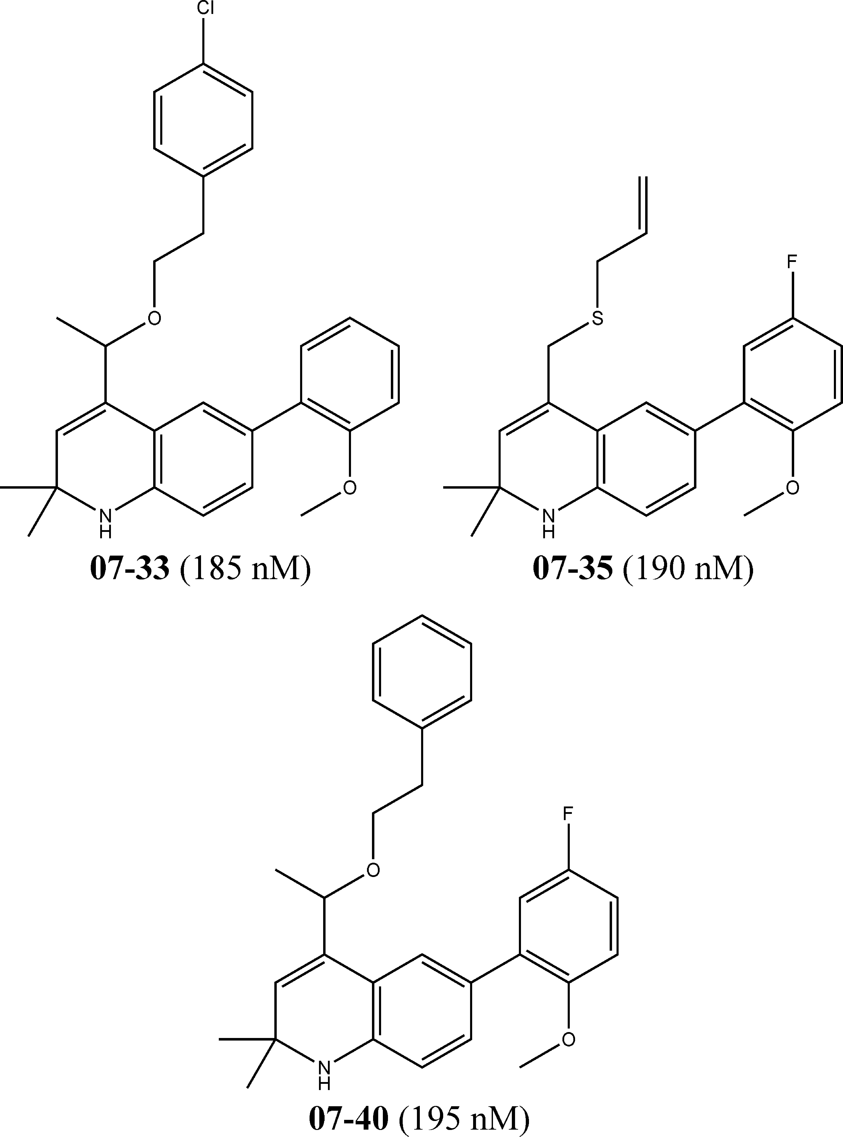
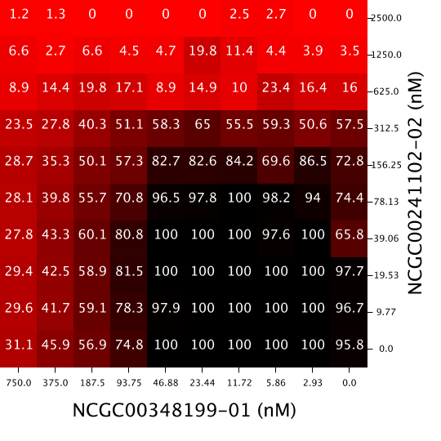
Introduction- Similarity Property Principle
Similarity Property Principle: “similar compounds have similar properties”
Will the similarity property principle hold for drug combinations?
Do similar drug combinations have similar properties?
Similar Compounds- tend to show similar activities (such as IC50)
Dissimilar Compounds- tend to show dissimilar activities
[reference]

Slide 6
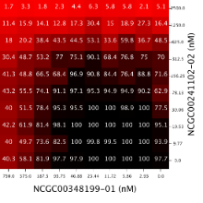
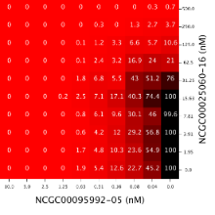
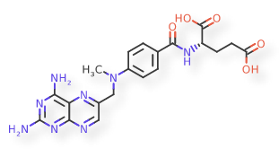
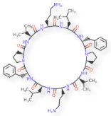
Overarching Questions
Question 1: What are metrics to quantify dissimilarity between two response matrices or synergy matrices?
Question 2: Does chemical structure correlate to combination response? Synergy? How?
Question 3: Does dose response correlate to combination response? Synergy? How?
Drug Combo A:
Response Matrix
Drug Combo B:
Response Matrix
Drug Combo A:
Compounds
Drug Combo B:
Compounds
Drug Combo A:
Dose Response
Drug Combo B:
Dose Response

Slide 7
Overarching Questions
Question 1: What are metrics to quantify dissimilarity between two response matrices or synergy matrices?
Question 2: Does chemical structure correlate to combination response? Synergy? How?
Question 3: Does dose response correlate to combination response? Synergy? How?
Drug Combo A:
Response Matrix
Drug Combo B:
Response Matrix
Drug Combo A:
Compounds
Drug Combo B:
Compounds
Drug Combo A:
Dose Response
Drug Combo B:
Dose Response

Slide 8
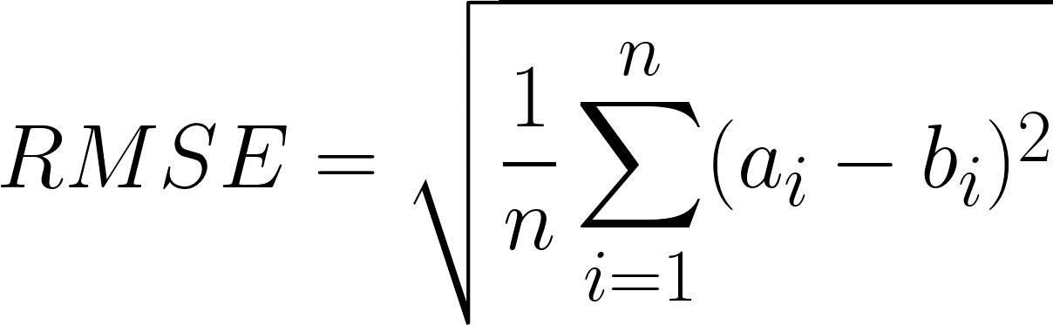
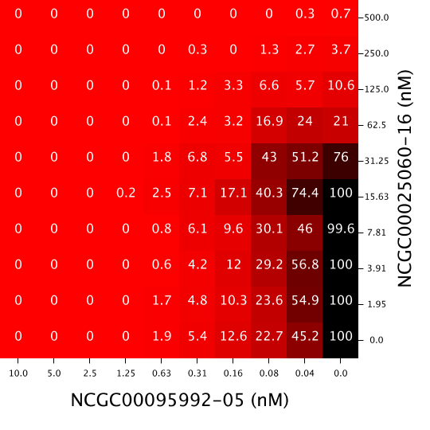
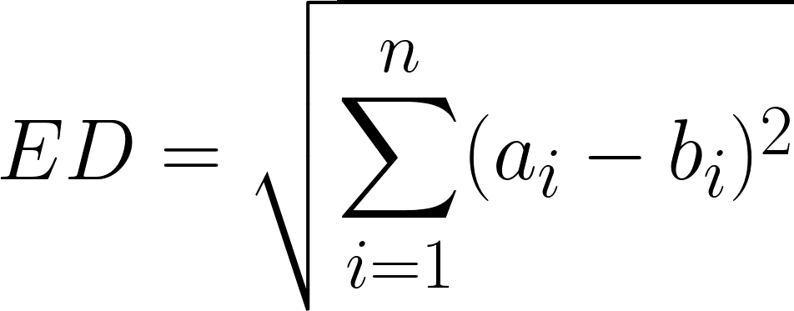
Question 1: Dissimilarity Metrics
Insensitive to Spatial Distribution
Sensitive to Spatial Distribution
1. Root Mean Standard Error (RMSE)
2. Euclidean Distance (ED)
3. Two- Sample Kolmogorov-Smirnov Test (KS Test)
4. Syrjala Test
Drug Combo A
Drug Combo B
Using these four metrics, dissimilarity was computed for all pairs of drug combinations

Slide 9
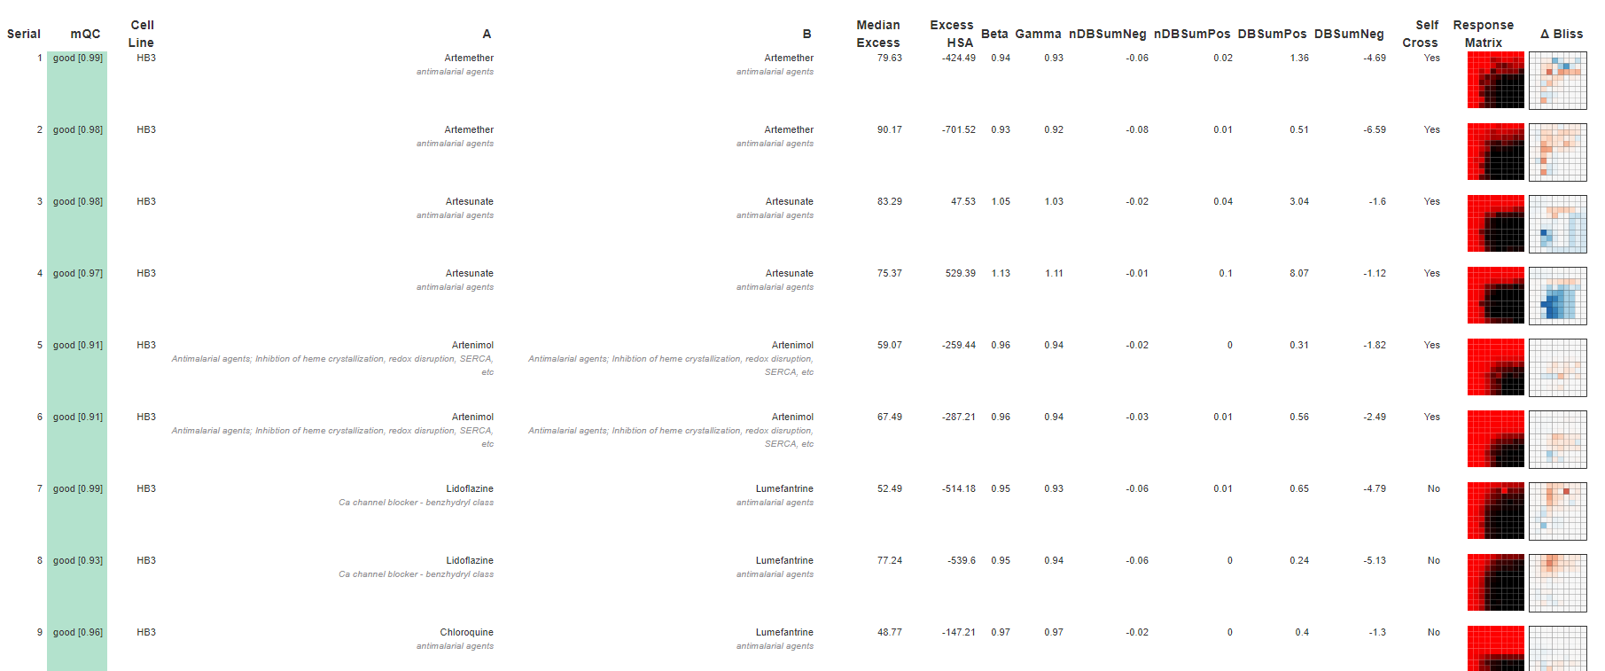
Question 1: Dissimilarity Metrics- Malaria AID 1764 (cell line HB3)
(First 9 drug combinations displayed; 480 total in the assay)

Slide 10
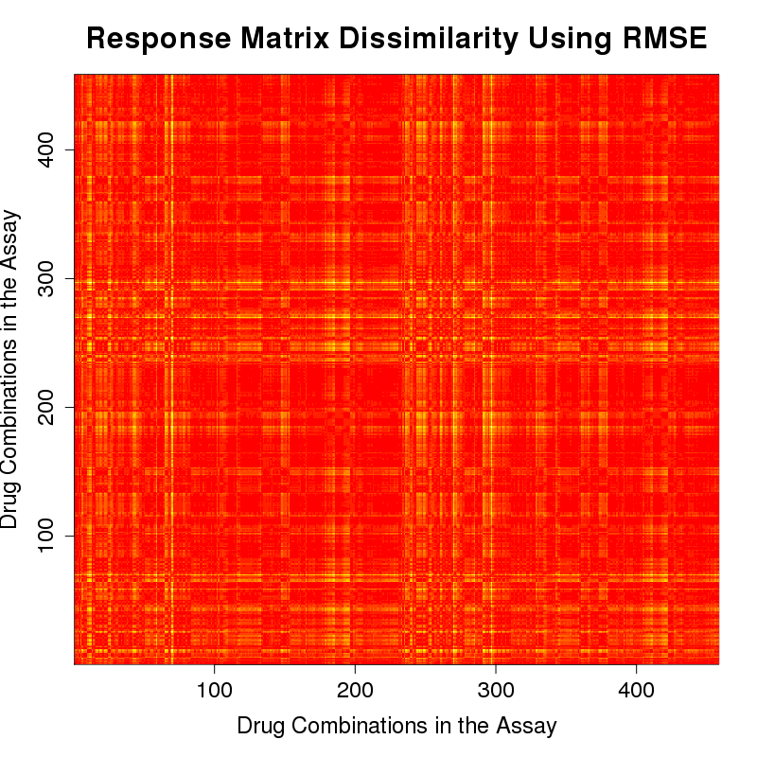
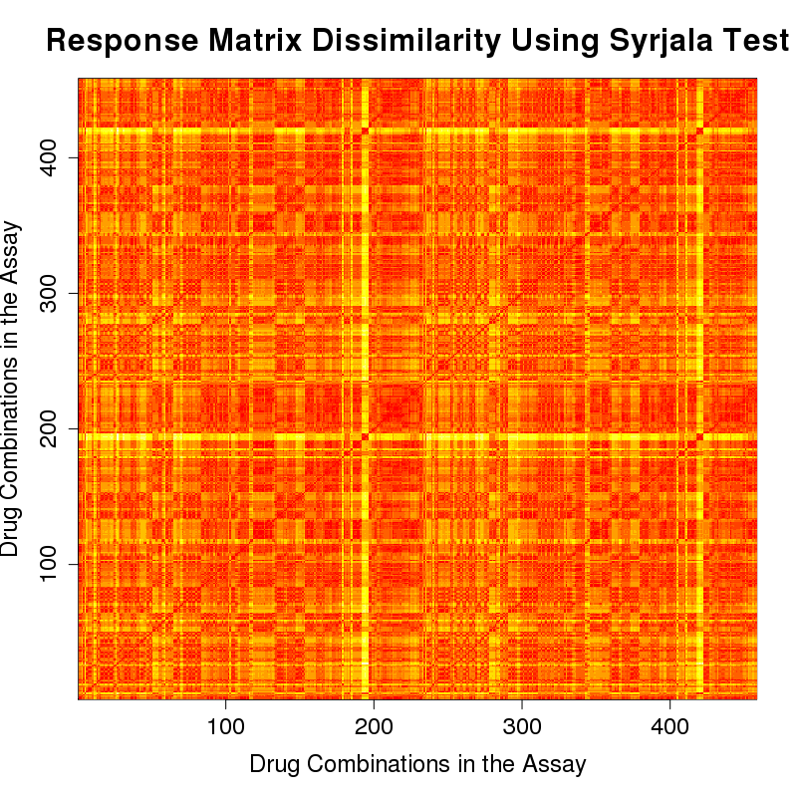
Question 1: Dissimilarity Metrics- Malaria Strain HB3 (AID 1764) Response Matrices
RMSE
Syrjala Test
Red- more similar
Yellow- more dissimilar

Slide 11
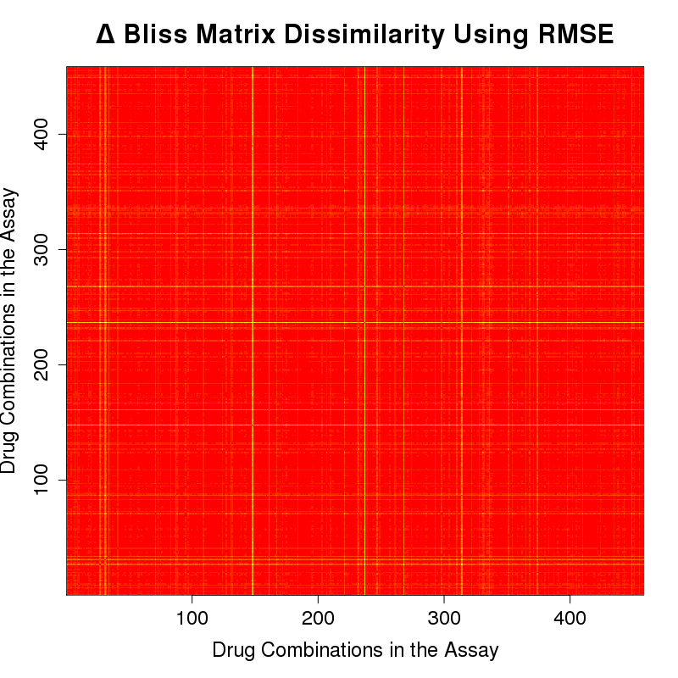
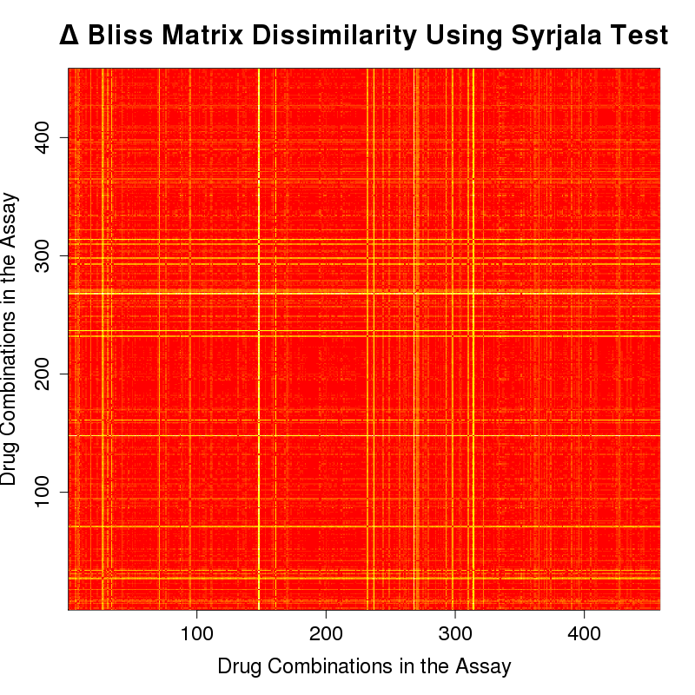
Question 1: Dissimilarity Metrics- Malaria Strain HB3 (AID 1764) Δ Bliss Matrices
RMSE
Syrjala Test
Red- more similar
Yellow- more dissimilar

Slide 12
Overarching Questions
Question 1: What are metrics to quantify dissimilarity between two response matrices or synergy matrices?
Question 2: Does chemical structure correlate to combination response? Synergy? How?
Question 3: Does dose response correlate to combination response? Synergy? How?
Drug Combo A:
Response Matrix
Drug Combo B:
Response Matrix
Drug Combo A:
Compounds
Drug Combo B:
Compounds
Drug Combo A:
Dose Response
Drug Combo B:
Dose Response

Slide 13

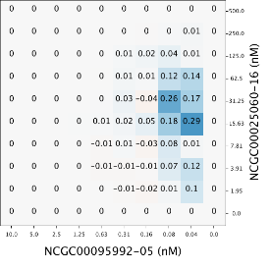
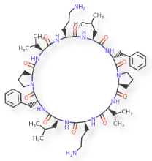
Question 2: Structure Correlated With Combination Response and Synergy
Is there a correlation between the dissimilarity of the compounds and the dissimilarity of the combination response surfaves? Δ Bliss (synergy) surfaces?

Slide 14
Question 2: Structure Correlated With Combination Response and Synergy- Dissimilarity of Compounds
Step 1. Compare one drug combination to another drug combination
Compare corresponding x agents
Compare corresponding y agents
Average those values
Step 2: Repeat for all pairs of combinations
x agents’ dissimilarity
y agents’ dissimilarity
Average dissimilarity

Slide 15
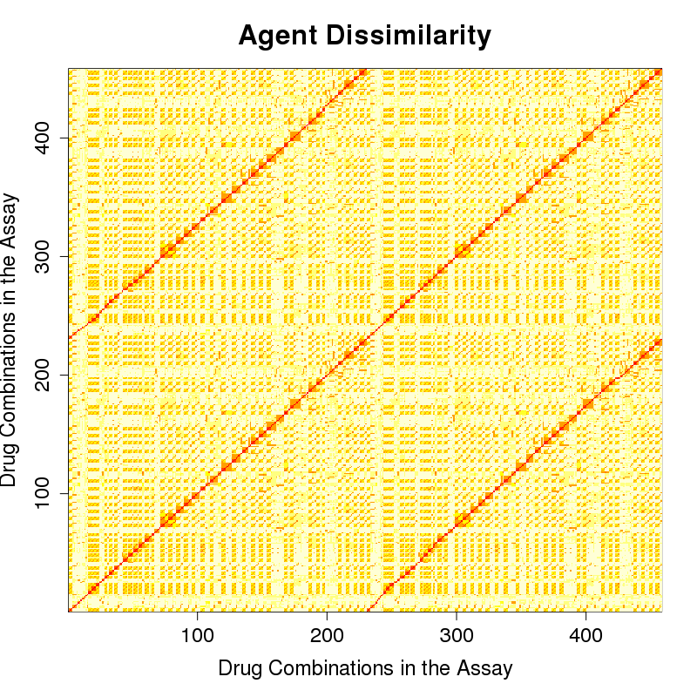
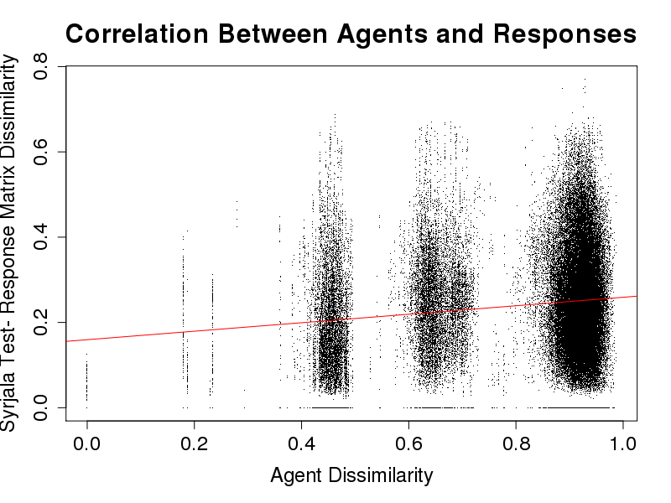
Question 2: Structure Correlated With Combination Response- Malaria Strain HB3 (AID 1764)
Agent Dissimilarities
Response Matrix Dissimilarities- Syrjala Test

Slide 16
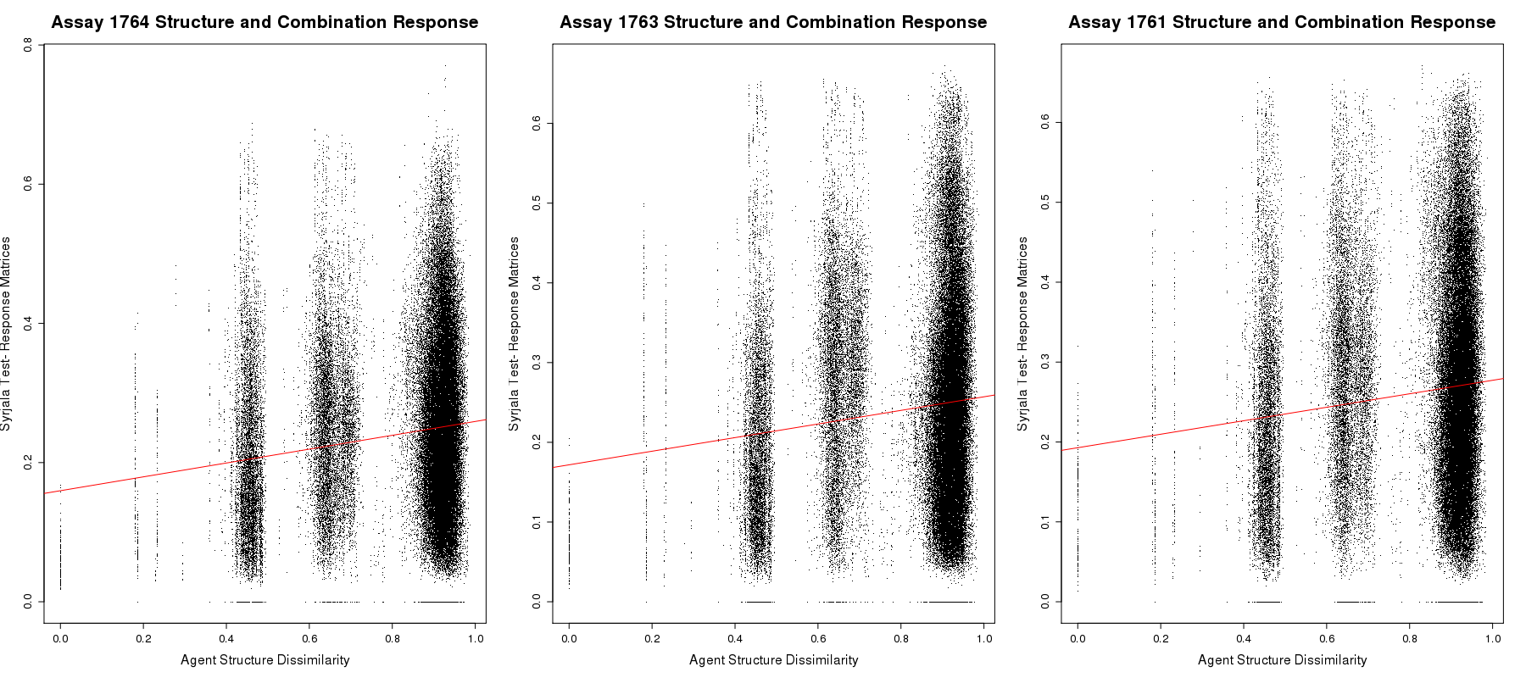
Question 2: Structure Correlated With Combination Response- Three Malaria Strains: HB3 (AID 1764), dD2 (AID 1763), 3D7 (AID 1764)

Slide 17
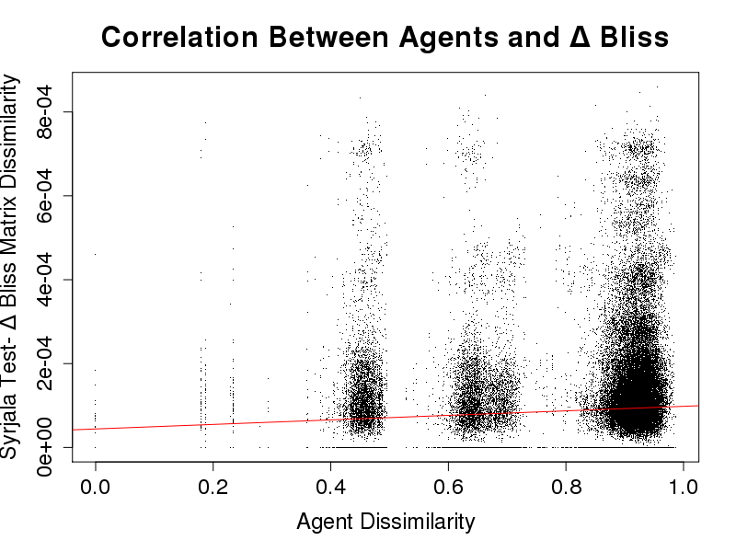
Question 2: Structure Correlated With Synergy- Malaria Strain HB3 (AID 1764)
Agent Dissimilarities
Δ Bliss (Synergy) Matrices- Syrjala Test

Slide 18
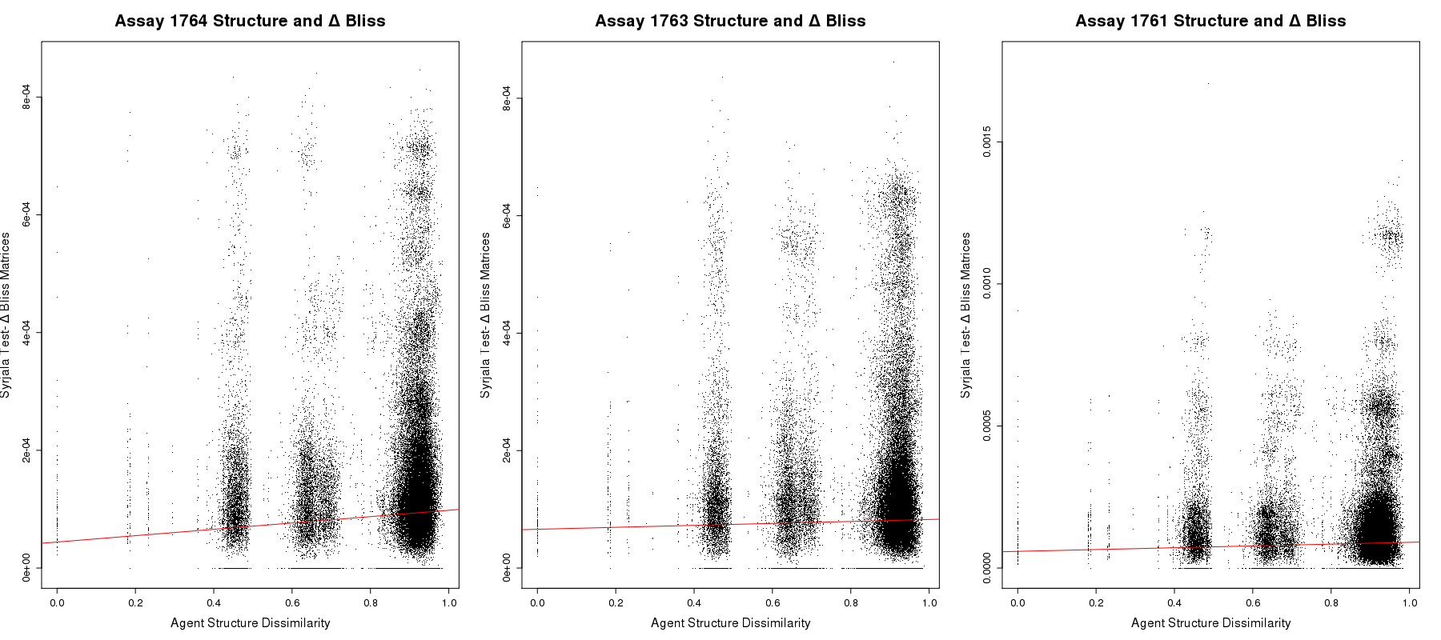
Question 2: Structure Correlated With Synergy- Three Malaria Strains: HB3 (AID 1764), dD2 (AID 1763), 3D7 (AID 1764)

Slide 19
Overarching Questions
Question 1: What are metrics to quantify dissimilarity between two response matrices or synergy matrices?
Question 2: Does chemical structure correlate to combination response? Synergy? How?
Question 3: Does dose response correlate to combination response? Synergy? How?
Drug Combo A:
Response Matrix
Drug Combo B:
Response Matrix
Drug Combo A:
Compounds
Drug Combo B:
Compounds
Drug Combo A:
Dose Response
Drug Combo B:
Dose Response

Slide 20
Question 3: Dose Response Correlated With Combination Response- Dissimilarity of Dose Responses
Step 1. Compare one dose response to another dose response using Lin’s CCC
Compare corresponding x agents
Compare corresponding y agents
Average those values
Step 2: Repeat for all combinations
x dose responses’ dissimilarity
y dose responses’ dissimilarity
Average dissimilarity
reference

Slide 21
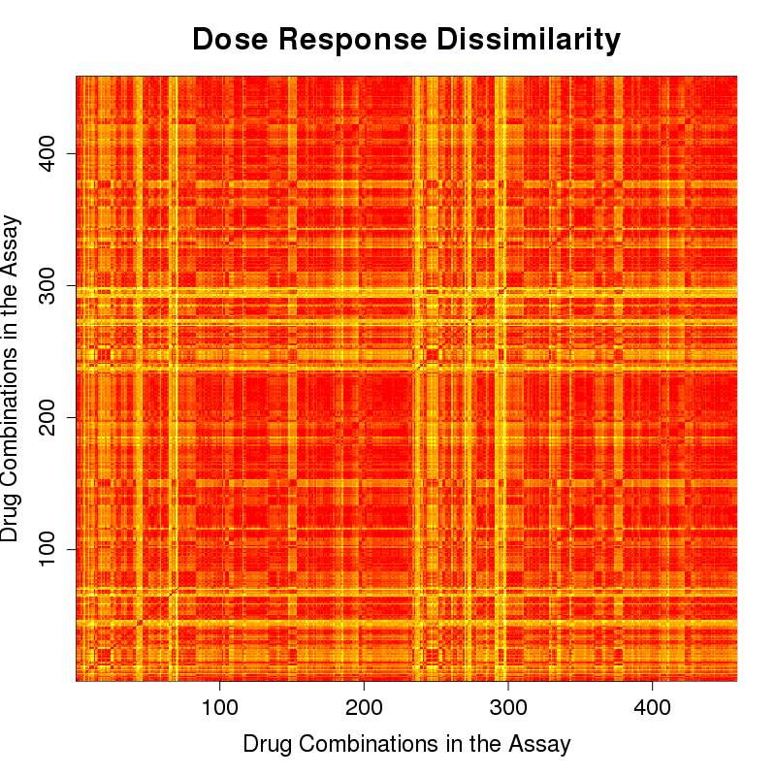
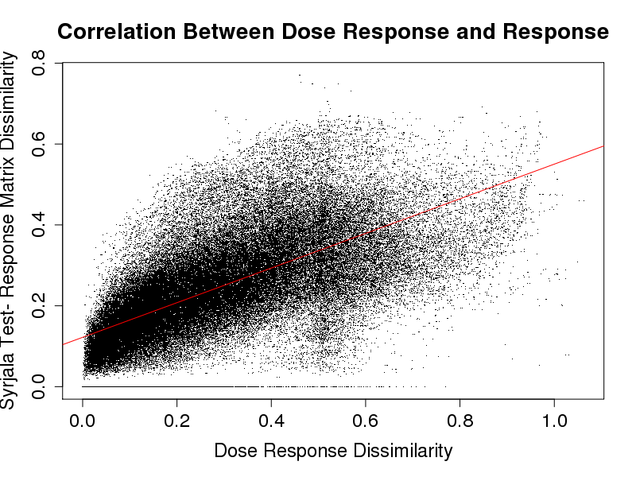
Question 3: Dose Response Correlated With Combination Response- Malaria Strain HB3 (AID 1764)
Dose Response Dissimilarities
Response Matrices- Syrjala Test

Slide 22
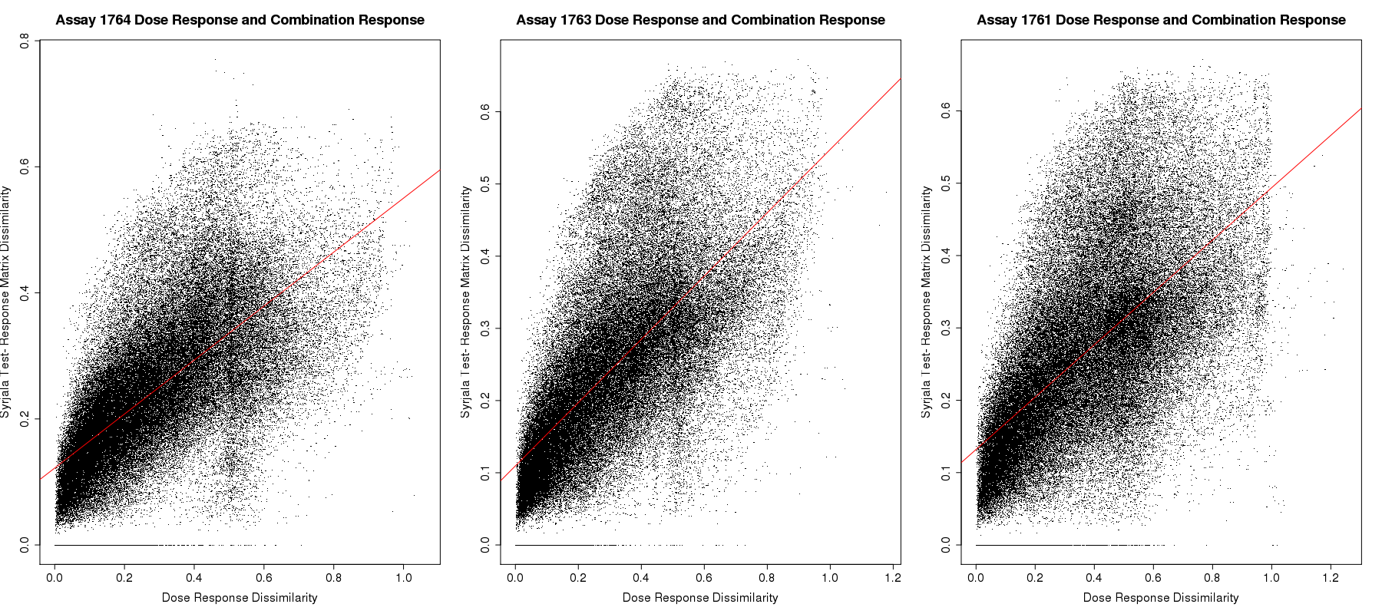
Question 3: Dose Response Correlated With Combination Response- Three Malaria Strains: HB3 (AID 1764), dD2 (AID 1763), 3D7 (AID 1764)

Slide 23
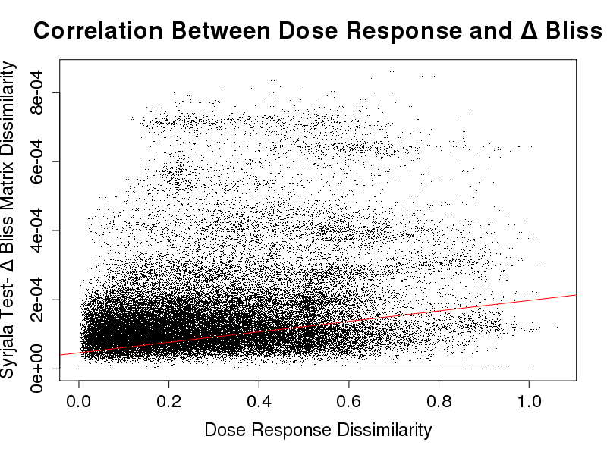
Question 3: Dose Response Correlated With Synergy- Malaria Strain HB3 (AID 1764)
Dose Response Dissimilarities
Δ Bliss (Synergy) Matrices- Syrjala Test

Slide 24
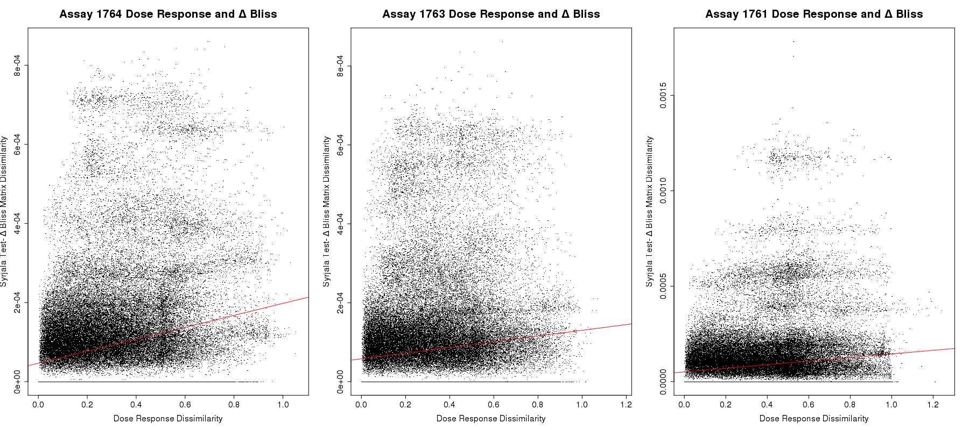
Question 3: Dose Response Correlated With Synergy- Three Malaria Strains: HB3 (AID 1764), dD2 (AID 1763), 3D7 (AID 1764)

Slide 25
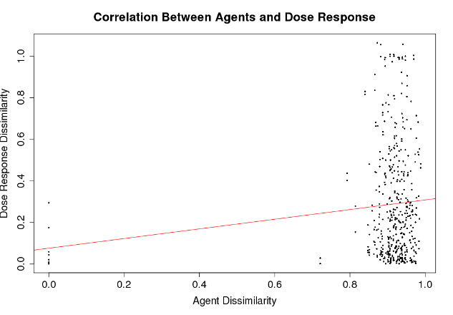
Conclusion
Individual Compounds: Structural similarity correlates to dose response similarity
Both plots do not show correlations
Drug Combinations: Similarity Property Principle does not seem to hold
Suggests that understanding drug combinations is more complex than understanding individual compounds
No correlation
Correlation

Slide 26
Discussion
The similarity property principle holds for drug combinations, but is likely very weak
Limitations of the study
What did we not calculate because of time? (looking at clustering)
Analysis only on 3 assays (need more to draw conclusions)

